Slide 1
Exercise 1

Slide 2
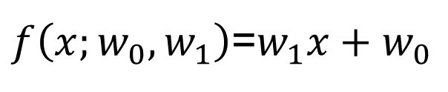

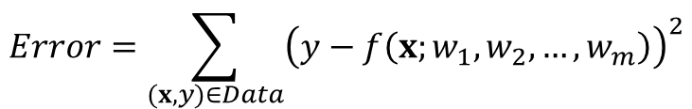
Goal of Machine Learning
다음 데이터를 가장 잘 설명하는 함수를 찾아라
$$\left(0.0, 0.0\right) \left(1.0, 1.0\right) (1.0, 2.0)$$
y
$f\left(x;w_{0},w_{1}\right)$=$w_{1}x+w_{0}$
$$Error=\sum_{(x,y)∈Data}{{\left(y−f\left(x;w_{1},w_{2},…,w_{m}\right)\right)}^{2}}$$
x

Slide 3
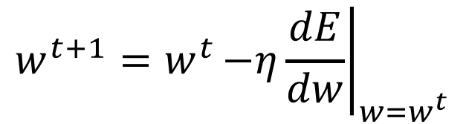
Gradient Descent Method
Steps
learning rate
Randomly choose an initial solution,
Repeat
Until stopping condition is satisfied
$${w^{t+1}=w^{t}\left.−η\frac{dE}{dw}\right|}_{w=w^{t}}$$
|w^{t+1} - w^{t}|is very small
f(w) little moves
fixed number of iterations

Slide 4

Coding 전에 생각해 볼 것
입력 데이터 : (0.0), (1.0), (1.0)
출력 데이터 : (0.0), (1.0), (2.0)
Optimizer: gradient descent method
Loss function: Mean square error
y
model
y
예측 값은?
x
$$w_{1}, w_{0}$$
x

Slide 5



준비 단계 1
입력 데이터 : (0.0), (1.0), (1.0)
출력 데이터 : (0.0), (1.0), (2.0)
Model: f(X; W₀, W₁) = W₁*X + W₀
Loss function : Error =∑ ( y-f(X; W1, W2,…., , Wm ))²

Slide 6
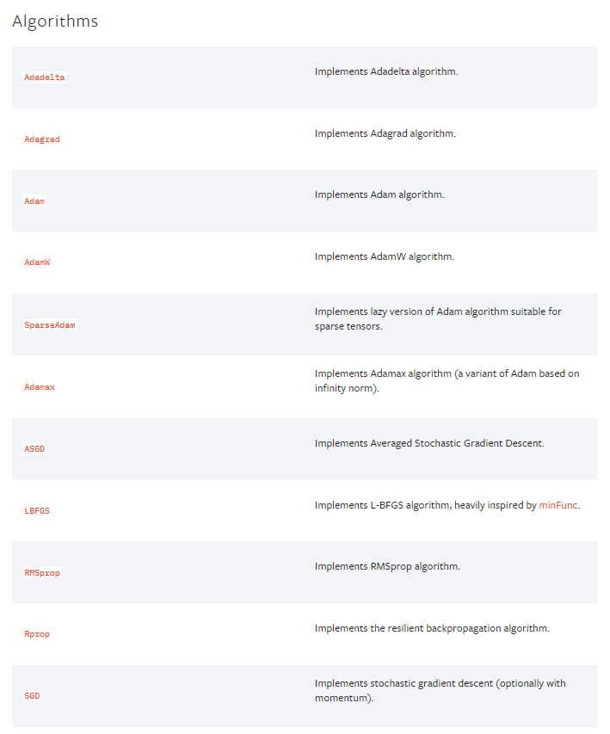
optimizer
Optimizer : SGD
https://pytorch.org/docs/stable/optim.html?highlight=optimizer#torch.optim.Optimizer

Slide 7
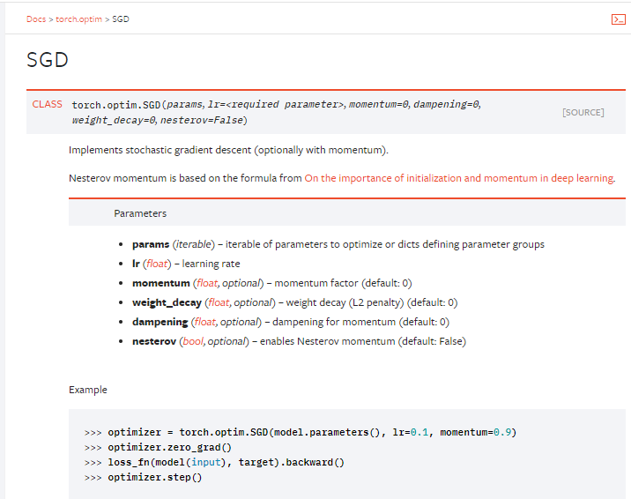
optimizer
Optimizer : SGD

Slide 8
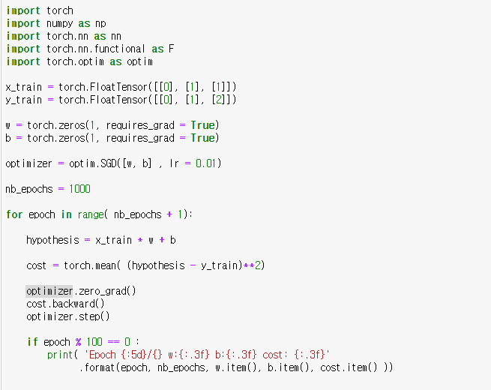
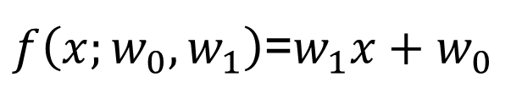
Exercise 1
$f\left(x;w_{0},w_{1}\right)$=$w_{1}x+w_{0}$

Slide 9
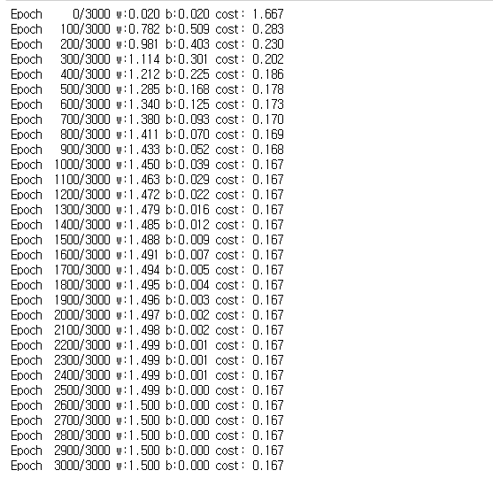
Exercise 1

Slide 10
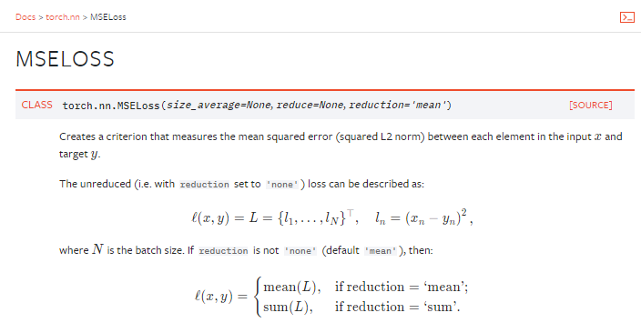
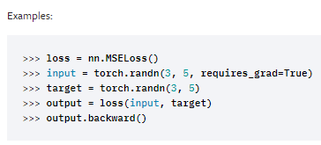
Quiz 1
Data : (x1, x2, x3) (Y)
hint
[a1, a2, a3]*[w1, w2, w3] =?
MSELOSS ?

Slide 11
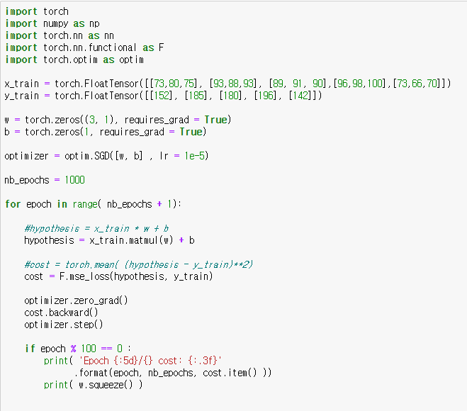
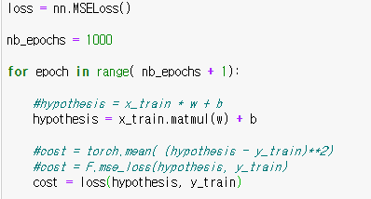
Answer 1

Slide 12
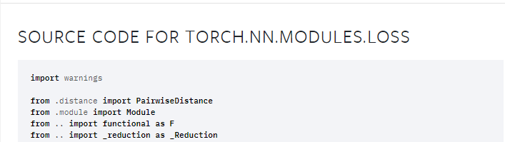
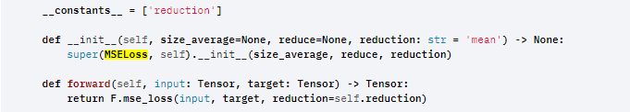
MSE Loss
Torch.nn.function : 함수, torch.nn : 클래스

Slide 13
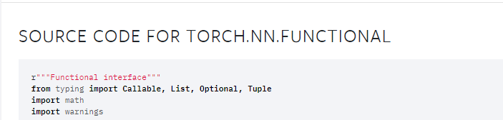
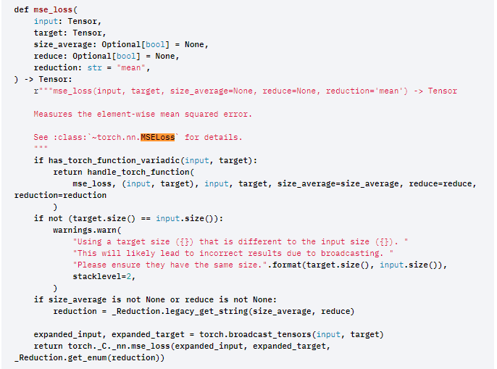

Slide 14
Tip
Data Preprocessing
# 데이터 x_train = torch.FloatTensor([[73, 80, 75], [93, 88, 93], [89, 91, 90], [96, 98, 100], [73, 66, 70]])
mu = x_train.mean(dim=0)
sigma = x_train.std(dim=0)
norm_x_train = (x_train – mu) / sigma
print(norm_x_train)

Slide 15
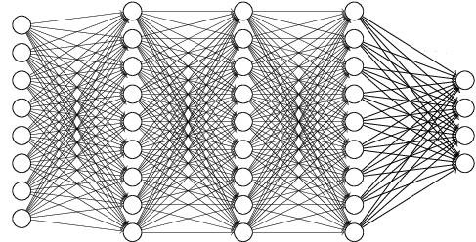
PyTorch Module
How can we make Deep Neural Network?
W = torch.zeros((3, 1), requires_grad=True) b = torch.zeros(1, requires_grad=True)

Slide 16
PyTorch Module
nn.Module (1)
import torch import torch.nn as nn import torch.nn.functional as F import torch.optim as optim class MultivariateLinearRegressionModel(nn.Module): def __init__(self): super().__init__() self.linear = nn.Linear(3, 1) def forward(self, x): return self.linear(x)

Slide 17
PyTorch Module
nn.Module (2)
# 데이터 x_train = torch.FloatTensor([[73, 80, 75], [93, 88, 93], [89, 91, 90], [96, 98, 100], [73, 66, 70]]) y_train = torch.FloatTensor([[152], [185], [180], [196], [142]]) # 모델 초기화 model = MultivariateLinearRegressionModel() # optimizer 설정 optimizer = optim.SGD(model.parameters(), lr=1e-5)

Slide 18
PyTorch Module
nn.Module (3)
nb_epochs = 20 for epoch in range(nb_epochs + 1): # H(x) 계산 prediction = model(x_train) # cost 계산 cost = F.mse_loss(prediction, y_train) # cost로 H(x) 개선 optimizer.zero_grad() cost.backward() optimizer.step() # 20번마다 로그 출력 print('Epoch {:4d}/{} Cost: {:.6f}'.format( epoch, nb_epochs, cost.item() ))

Slide 19
Pytorch
GPU
import torch import numpy as np
device = torch.device('cuda' if torch.cuda.is_available() else 'cpu’) print(device)
#net = Model.to(device)
#inputs = data.to(device)

Slide 20
Question and Answer

